Slide 1
EasyMerge
A new tool for code clones refactoring
H. Qin, S. Pan, Y. Chen

Slide 2
Background
A code fragment (CF) is any sequence of code lines (with or without comments). A CF is identified by its file name and begin-end line numbers in the original code base.
A code fragment CF₂ is a clone of another code fragment CF₁ if they are similar by some given definition of similarity, that is, f(CF₁) = f(CF₂) where f is the similarity function.
Previous research shows that a significant fraction (between 7% and 23%) of the code in a typical software system has been cloned.
By detecting, categorizing, and removing code clones we can produce easier to understand, cleaner, and more reusable code.

Slide 3
Clone Types
Type-1: Identical code fragments except for variations in whitespace, layout and comments.
Type-2: Syntactically identical fragments except for variations in identifiers, literals, types, whitespace, layout and comments.
Type-3: Copied fragments with further modifications such as changed, added or removed statements, in addition to variations in identifiers, literals, types, whitespace and comments.
Type-4: Two or more code fragments that perform the same computation but are implemented by different syntactic variants.

Slide 4
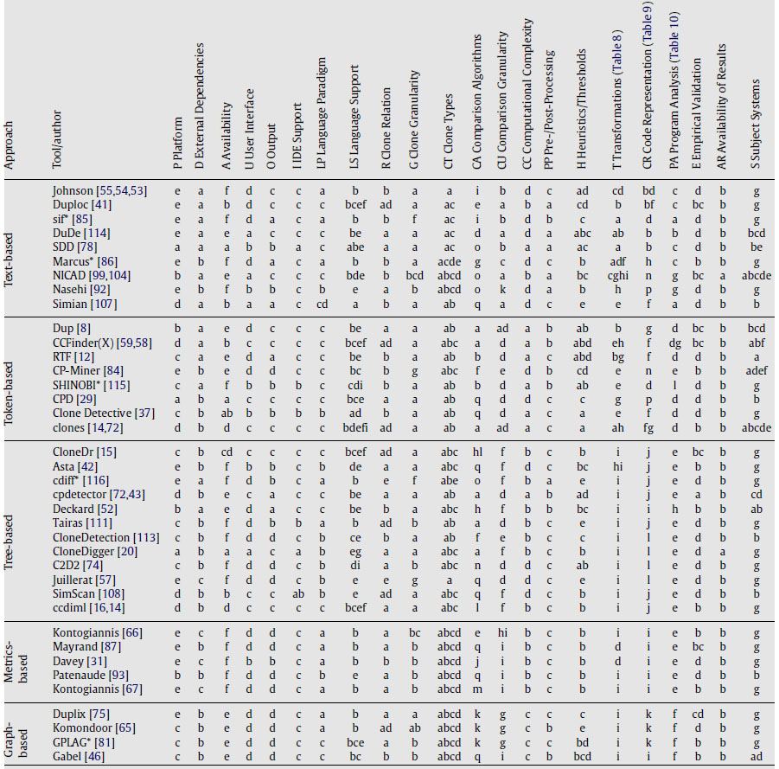
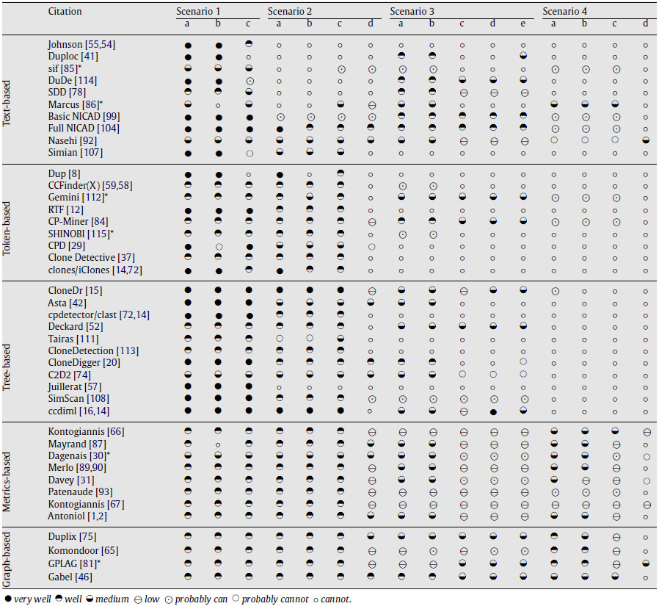
Clone Detection

Slide 5

CloneDigger – Anti-Unification
Anti-unification: let E₁ and E₂ be two terms. Term E is a generalization of E₁ and E₂ if there exist two substitutions $σ$₁ and $σ$₂ such that $σ$₁(E) = E₁ and $σ$₂(E) = E₂. The most specific generalization of E₁ and E₂ is called anti-unifier. The process of finding an anti-unifier is called anti-unification.
The anti-unifier tree of two trees T₁ and T₂ is obtained by replacing some subtrees in T₁ and T₂ by special nodes, containing term placeholders which are marked with integers.
Let U be the anti-unifier of two trees, the anti-unification distance between them is a sum of sizes of all substituting trees in their substitutions.

Slide 6
CloneDigger – Clone Detection Algorithm
Build the AST for the program.
Identify similar statements using anti-unification and partition them into clusters.
Find identical sequences of cluster IDs. These are candidates to be reported as duplicate code fragments.
Refine by examining the identified code sequences for overall similarity. In this phase, every pair of candidate sequences is checked for overall similarity at the statement level, again using anti-unification.

Slide 7
Clone Refactoring
Extract Method
Pull Up Method*
Possible implications
External references such as variables, objects and function calls
Future references
Related works: usage of refactoring guidance metrics

Slide 8
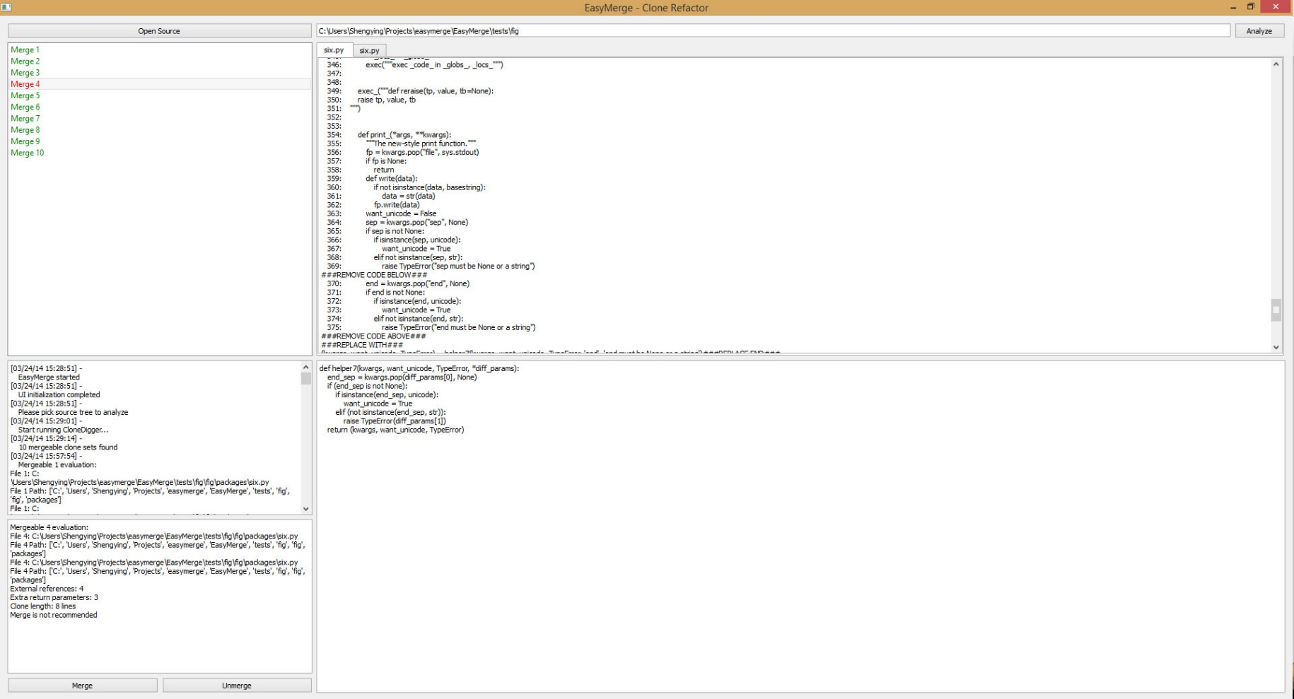
EasyMerge - UI

Slide 9
EasyMerge - Preprocessing
Get clone pairs from CloneDigger
Threshold: Distance<=10, Size>=4, Distance<=Size
Filter which not appropriate to merge
Merge clone pairs into clone sets
Remove overlapped clone sets
Separate Function Definitions with other Statements
Class definitions, Import statements, Return statement

Slide 10
EasyMerge - Classification
Type1 clones vs. Type2/3/4 clones
Clones in the same file vs. in different files
Function definitions vs. Statements blocks

Slide 11
EasyMerge – Merging Objective
Statements block
definition of vars, objs, calls
statements block
(using those vars, objs, calls above)
Continue to use those vars, objs
definition of vars, objs, calls
statements block
(using those vars, objs, calls above)
Continue to use those vars, objs
definition of vars, objs, calls
(vars, objs) = helper_func (vars, objs, calls)
Continue to use those vars, objs
definition of vars, objs, calls
(vars, objs) = helper_func (vars, objs, calls)
Continue to use those vars, objs
def helper_func (vars, objs, calls):
……
statements block
…..
return (vars, objs)

Slide 12
EasyMerge – Merging Objective
Function definition
def func1 (param):
……
statements
…..
return val1
Calls like:
val1 = func1 (param1)
def func2 (param):
……
statements
…..
return val2
Calls like:
val2 = func2 (param2)
def helper_func (param):
……
statements
…..
return val
Calls like:
val1 = helper_func (param1)
Calls like:
val2 = helper_func (param2)

Slide 13
EasyMerge – Merging Procedure
Preparation – get deeper information from AST
All the packages imported
All classes definitions and their scopes
All functions definitions and their scopes
All function-calls and the scopes they are in
Merging Mechanism
Step1: Generate “merged codes” for each duplicates
Step2: Compare those “merged codes”
Step3: Merge those “merged codes” into one
Step4: Modify codes in each duplicates
Duplicate1
Duplicate2
step1
step1
Merged code1
step2
Merged code2
step3
step3
Merged result

Slide 14
EasyMerge – Merging Step1
Scan the clone code, find the variables, objects, function calls which are defined externally
Add those external variables, objects, function calls to the helper function’s parameter list
Scan the source file, find the variables, objects which are used after the clone code
Add those variables, objects to the return values of the helper function
Construct the helper function with signature line, body block and return statement
Generate new calling statements for each duplicates

Slide 15
EasyMerge – Merging Step2&3
Check clone type, see if it’s Type1 clone
N
Check symbol tables of the merged codes,
see if they are Type2 clone
Y
Y
N
Compare symbols in symbol table
Not mergeable
Compare parameters and return values
Generate common symbol table
Generate common parameters and return values
Update symbols in codes
Update parameters, return values and calling statements
Do procedures as the left
Get unified merged code

Slide 16

EasyMerge – Recommendation
What we can merge but we shouldn’t merge
The duplicates are in different packages or libraries
Too many external references or return values
Recommendation evaluation formula
$f\left(RE\right)=w_{1}∗L−w_{2}∗E−w_{3}∗R−w_{4}∗D$
L = code length
E = number of external references
R = number of return values
D = “package/lib distance” between duplicates
$w_{1}=0.5; w_{2}=1; { w}_{3}=2; w_{4}=2$
Recommending threshold
$f\left(RE\right)≤0; 0<f\left(RE\right)≤8; f\left(RE\right)>8$

Slide 17
Evaluation
Environment
AMD FX 3.5GHz 6 cores CPU, 16GB RAM
Ubuntu Desktop 12.04, Python 2.7.5
Test data
5 most famous Python projects in Github
Scrapy, Pymongo, Reddit, Redis Python Client, Tornado
6 randomly selected Python projects in Github
PyStruct, Tweepy, YouTube-dl, Beets, Fig, Wagtail

Slide 18
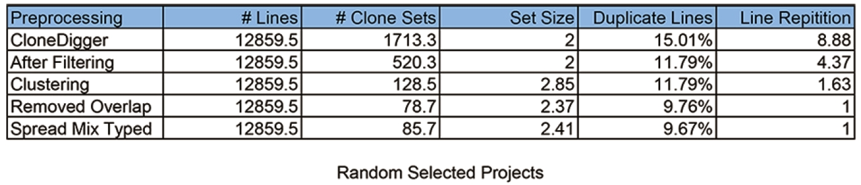
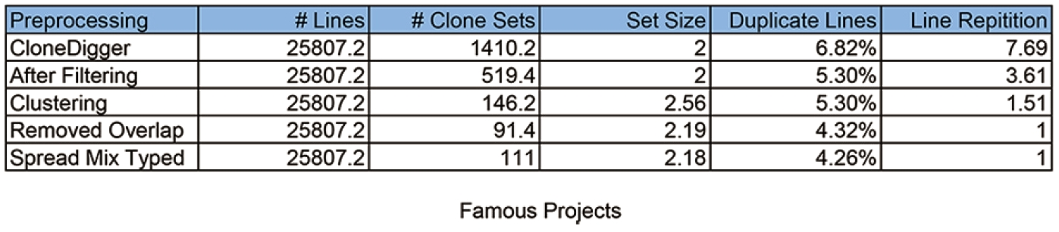
Experimental Results - Preprocessing

Slide 19
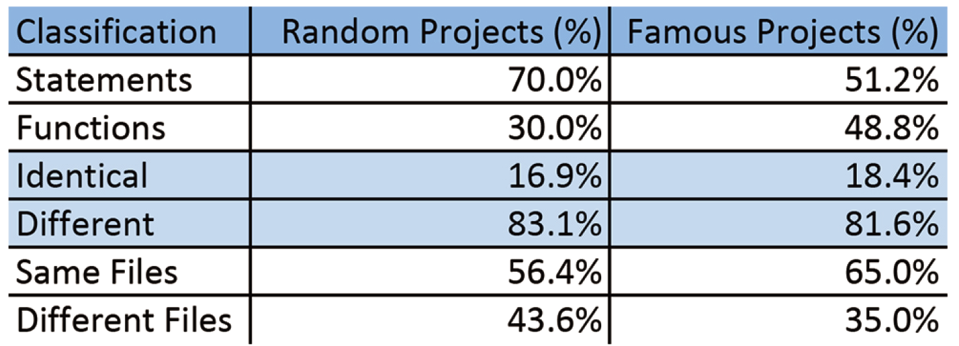
Experimental Results - Classification

Slide 20
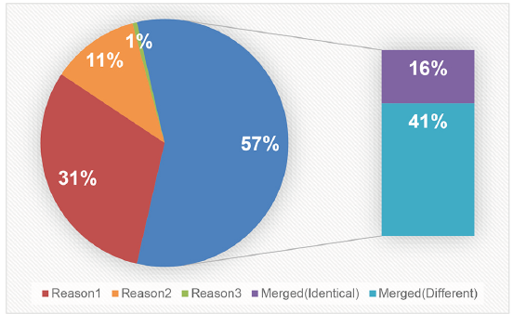
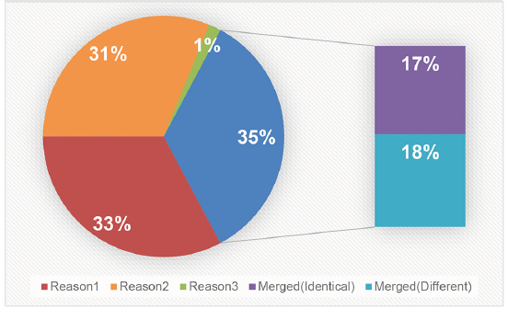
Experimental Results - Mergeability

Slide 21
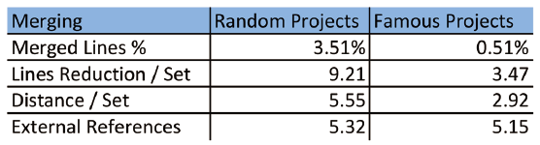
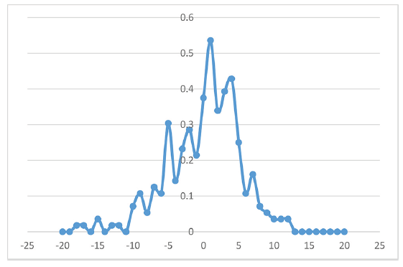
Experimental Results – Merge results & Recommendation evaluation results

Slide 22
Conclusion & Future Work
EasyMerge can merge most Type-1 clones and around half of Type-2 clones.
A lot of seemingly simple scenarios contain subtle and tricky implications. We didn’t have time to finish all features we planned.
In the future, we can try to merge Type-3 clones. And to merge Type-4 clones, we need to replace CloneDigger with a better clone detection tool. And Type-4 clones will be really tricky to merge.
Survey real developers to develop better recommendation formula.
Add more intelligence to EasyMerge to handle test suites and independent libraries automatically.

